Slide 1
The American Civil War

Slide 2
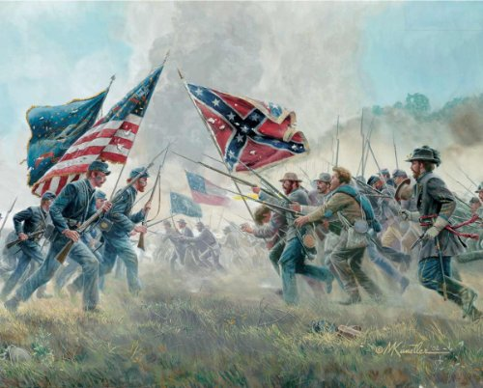
What Was The Civil War?
The Civil War was a war between
the States of America
The war occurred between 1861 and 1864

Slide 3
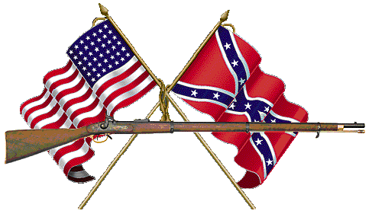
Why A Civil War?
1
11 southern Slave States - Confederates-
2
20 Free States - Union
3
Border States
.
Notes:
http://americanhistory.about.com/od/civilwarmenu/a/cause_civil_war.htm

Slide 4
REASONS FOR THE CIVIL WAR
Economic and social differences between the North and the South
States versus federal rights
The fight between Slave and Non-Slave State Proponents
Growth of the Abolition Movement.
The election of Abraham Lincoln

Slide 5
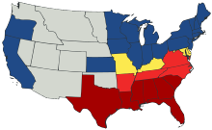
Division of states IN THE CIVIL WAR
Blue Union states that forbade slavery
Yellow – union states that allowed slavery
Red States – Confederates
Light Red – joined the confederates after 1861
Grey - unaffiliated

Slide 6
Civil War Timeline
1861 – The South secedes
1861 Abe Lincoln will not accept secession
1861 – Attack on Fort Sumpter
1862 Lincoln issues war order – many battles ensue
1863 – Emancipation Proclamation
1863 – Gettys burg Address
1864 – Union General sherman’s march to the sea
1865 - Surrender of confederate General Lee – End of the Civil War
1865 – Assassination of AbE Lincoln

Slide 7
Civil War Vocabulary
Words to Know
Secede
Union
Civil
War
Slavery
Confederation
Emancipation
Proclamation

Slide 8
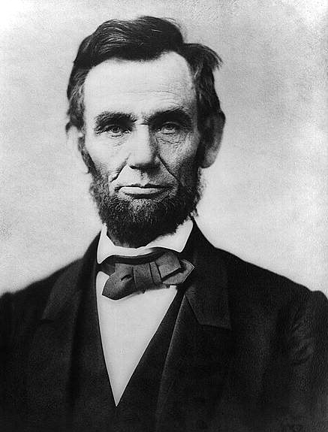
Who Was Abraham Lincoln?
Abe Lincoln was the 16th president of the United States
Abe Lincoln led our nation during the Civil War

Slide 9
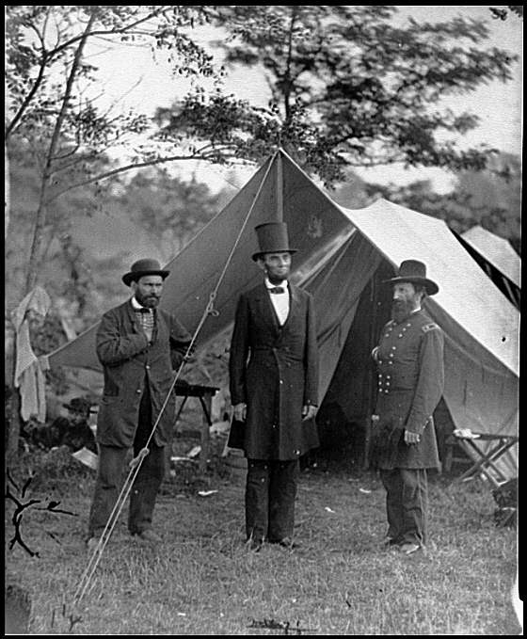
Abraham Lincoln Facts
Abe Lincoln was famous for his speeches – Emancipation Proclamation and Gettysburg’s address
He also helped to end slavery in the United States
Notes:
http://www.2020site.org/fun-facts/Fun-Facts-About-Abraham-Lincoln.html

Slide 10
Abe’s Character Traits
Determination
Perseverance
Self disciplined
Leader
Patriotic
Honest
Amicable

Slide 11
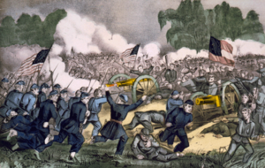
BATTLE OF GETTYSBURG
July 1 – July 3, 1863
Costliest Battle of the war
Gettysburg, Pennsylvania
28,000 Confederate soldiers died
Union army won this battle
Lincoln gave the Gettysburg address at the funeral of the soldiers
.
51,000 Casualties

Slide 12
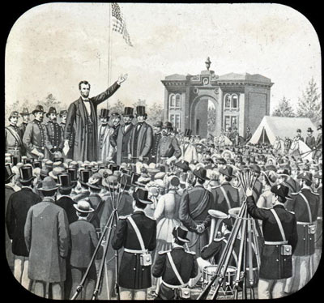
Gettysburg Address
Lincoln’s famous speech
The Gettysburg Address,

Slide 13
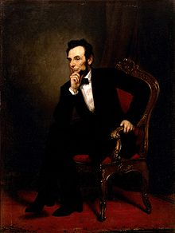
Abe and The Civil War Links
.Abe Lincoln and Civil War Info.docx

