Slide 1
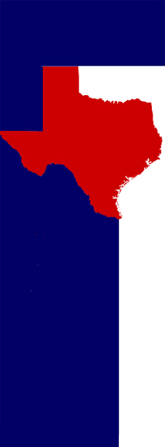
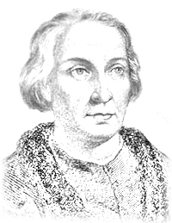
Christopher Columbus
In 1492, Christopher Columbus left Spain after being given permission to sail to India from King Ferdinand and Queen Isabella. His purpose was to find a new trade route to India and to bring back spices from India. Spices were as valuable as gold. On his way across the Atlantic Ocean, Columbus sailed to a new land and met new people which he called “Indians” thinking he had landed in India. Because of Columbus, a new age of exploration of North America began.
My Texas
History
Notebook :
Explorers
Of Texas
University of North Texas Libraries

Slide 2
Alonso Alvarez de Piñeda
The year 1519 was very important for Alonso Alvarez de Piñeda and for Texas. Piñeda sailed along the Texas coast toward Mexico. During his journey, he created the first maps and charts of the coast. Because of Piñeda, future explorers knew where to sail to get to Texas.
My Texas
History
Notebook :
Explorers
Of Texas
University of North Texas Libraries

Slide 3
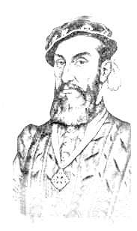
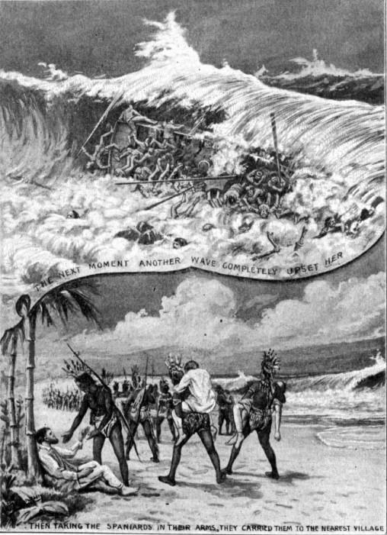
Álvar Núñez Cabeza de Vaca
One of the most amazing journeys took place in Texas. In 1529, Cabeza de Vaca crashed on Galveston Island because of a hurricane. He was captured by an Indian tribe and almost became a slave. Luckily, Cabeza de Vaca knew enough about medicine that he was able to heal many Indians. He became known among the tribe as a “medicine man.” When he made it to Mexico he told others about many wonderful cities made of gold. Who would be the first explorer to find and capture these rich cities?
My Texas
History
Notebook :
Explorers
Of Texas
University of North Texas Libraries

Slide 4
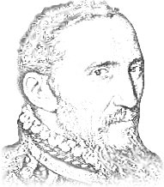
Francisco Vásquez
de Coronado
Gold! In 1540, Francisco Vásquez de Coronado was placed in charge of a great search to find the City of Gold. With 1,000 men, 1,500 horses, mules, wagons, cooks and farm animals, Coronado and his group headed north. When Coronado thought he found the City of Gold, it was only mud bricks reflecting the sun, making it look bright and shiny. The city was really an Indian village. Coronado did not give up. He kept searching and found more villages and people as he went.
My Texas
History
Notebook :
Explorers
Of Texas
University of North Texas Libraries

Slide 5
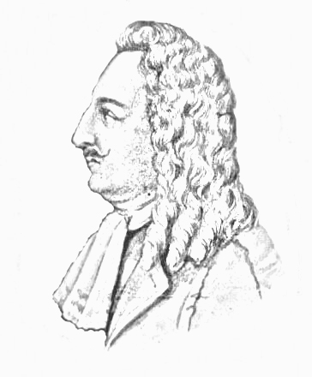
Rene Robert Cavalier,
Sieur de LaSalle
France wanted to claim the area around the Mississippi river before the Spanish got there. So in 1684, the French King, Louis XIV, gave LaSalle ships and colonists to set sail. After a scary journey, LaSalle’s group missed the Mississippi river and actually landed near Matagorda Bay, Texas. LaSalle set up Fort St. Louis in 1865. Because of LaSalle’s new French settlement, Spain hurried to build more missions throughout the area, hopefully to push France off the land.
My Texas
History
Notebook :
Explorers
Of Texas
University of North Texas Libraries

