Slide 1
Social Studies Overview
Exploration Leads to Texas

Slide 2
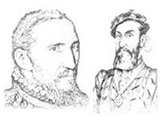
Who Were Explorers ?
An explorer is someone who comes to a land that they do not know about
.

Slide 3
Why Explorers?
G
God
Religion
G
Gold
Riches
G
Glory
Power
.

Slide 4
Explorers Timeline
Columbus – 1492
Cortes - 1519
Pineda - - 1519
CABEZA DE VACA - 1528
Coronado -- 1540
La Salle - 1685
Notes:
Columbus lands in San Salvador, cortes reaches Mexico, Pineda – 1st European to see Texas, Cabeza – stranded in Texas, Coronado. La Salle- french

Slide 5
Vocabulary
Words to know
empire
expedition
Esteban

Slide 6
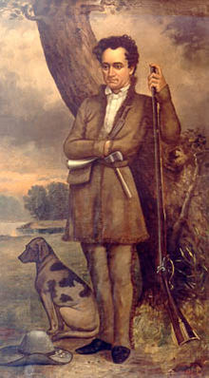
Who Were Empresarios
An empresario is someone who takes land for their country
Stehen Austin was one of the greatest Texan Empresarios

Slide 7
Stephen S Austin
An empresario is someone who takes land for their country
Austin had brought 297 families to Texas by 1825. He is known as the father of Texas. His father was Moses Austin

Slide 8
Social Studies Overview
Missions and Presidios

Slide 9
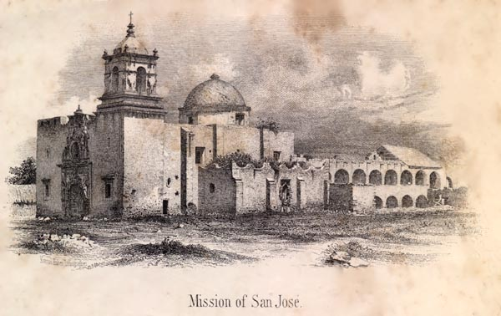
What is a Mission
A mission
A mission was a Spanish religious settlement. The Spanish built missions with help from the Roman Catholic church,

Slide 10
More on missions
Missions often included a church, houses and farm buildings

Slide 11
Food for Thought
Did you know the ysleta mission originally stood on the south side of the rio grande. As the years passed, the river slowly changed its course. Today the mission sits on the northern bankof the river

Slide 12
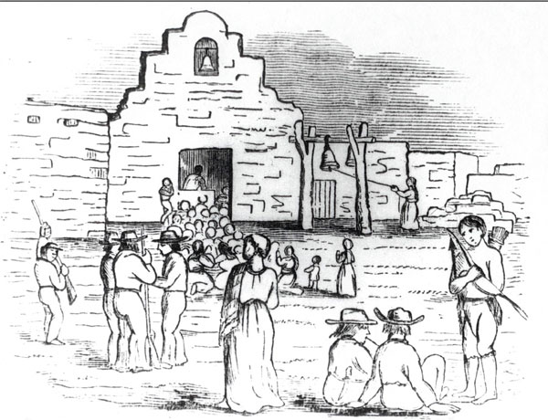
WHAT IS A PRESIDIO
Presidios were forts built to protect the people living in the missions

Slide 13
Fast Facts on Presidios
Presidios were surrounded by walls
There were many buildings inside the Presidios
Sometimes soldiers placed cannons on top of the walls
Buildings housed soldiers and their families, weapons and supplies

Slide 14
Food for Thought
Did you know that many early towns in texas began as missions or presidios?

Slide 15
Vocabulary
Words to know
mission
missionary
presidio

Slide 16
Research means to look for information
Watch
Videos
Movies
Resources
Internet
Periodicals
Books
Video Streaming
Almanacs
Ask an expert
CD’s
Magazines
Encyclopedias
Newspapers

