Slide 1
The Narrative Writing Diamond

Slide 2
The Entertaining Beginning
The Beginning must “hook” the reader and make them feel compelled to read on. The author might use:
Action
Dialogue/ exclamation
Thoughts/ question
A Sound
Stories should begin as close to the main event as possible.

Slide 3
Elaborative Detail Description of Setting, Character or Object
A descriptive segment (3-4 sentences) which describes a story critical setting, character, or object will draw the reader in and help the reader experience the fictional world through the five senses of the main character.
If the setting is mundane or boring (an average kitchen, the school yard, etc.) the author may choose to describe an important character or object instead

Slide 4
Suspense
Here the author moves toward the main event by building suspense or a sense of anticipation.
This might involve raising worry, wonder, concern, or doubt, all of which build tension. This can be done through the use of
“Story Questions”
“Word referents”
“The magic of three”

Slide 5
The Main Event- Show action in slow motion, frame by frame, stretch it out! Include description and main character’s thoughts and feelings!
Most important part of the story- the climax, the event that the entire story has led up to- essentially what the whole story is about.
The main event section involves the problem/struggle sequence, or the adventure or interesting peak experience.
This “scene” should be told in almost slow motion, expanded upon and stretched out through a balance of action, thought, description, and dialogue.
This is the largest, most significant part of the story.

Slide 6
The Solution/ Conclusion- Action leading to SOLUTION of problem or CONCLUSION of adventure
This is the section that brings the main event to a close.
The problem is solved or the adventure or experience comes to an end.

Slide 7
Extended Ending- Memory, Decision, Feeling, Wish
The ending summarizes the main character’s thoughts, feelings, memories, hopes, wishes, or decisions in regard to the main event.
It might also include a defining action that SHOWS any of the above.
The extended ending should not be abrupt, rather it should have a feeling of satisfied closure.

Slide 8
The Beginnings of stories, just like first impressions, are extremely important. (Narrative Writing Pg. 47)
Starters to avoid
One sunny day… One Rainy afternoon…One dark Night…
This story is about…
Hi, my name is…
I woke up, got dressed and had breakfast. Then I...

Slide 9
Function of the a story beginning
Beginning should introduce the reader to:
The Main character
The story setting
The purpose for the story action.
MOST IMPORTANTLY- Should capture the reader’s interest and hook the reader into reading on.

Slide 10
“In Medias Res”- in the middle of things
The place to begin a story is not really at the VERY beginning.
The story should begin as close to the main event as possible.
If the main event in a story takes place on a beach, don’t begin the story at home waking up- begin at the beach.

Slide 11
Ways to Start a Story
An Action- Put the main character in the setting doing something interesting and relevant.
Dialogue- Have the main character say something that expresses a feeling, creates worry, or raises the reader’s interest or curiosity. It could be an EXCLAMATION.
A Thought/ Question- show what the main character is thinking or worrying about.
A Sound- A story-relevant sound effect or a description of a sound is a great attention getting technique.

Slide 12
Questions to Ask with Each Opening
An Action- What would you do?
Dialogue/Exclamation- What would you say or exclaim?
A Thought/ Question- What would you be thinking, wondering, or worrying?
A Sound- What would you hear?

Slide 13
This is a story about how I found a fairy in the woods.
An Action: What would you do?
I walked along the shady forest path on a magical afternoon.
(The action places the reader immediately into the setting. The magical reference hints at (foreshadows) but doesn’t give away the main event.)
Dialogue: What would you say or exclaim?
“What a magical day for a walk in the woods!” I said. (the exclamation establishes the setting and the tone of the story and sets a purpose for the action.)

Slide 14
A Thought/ Question: What are you thinking, wondering, or worrying?
Today seems sort of magical, I thought as I looked out into the forest.
(The thought, followed by the action raises story questions- What is magical about it? What do you see in the forest?)
A Sound: What would you hear?
Zing! Woosh! I spun around and stared into the forest. What had made that peculiar sound?
(The sound effect is unusual enough to grab the reader’s attention. It raises story questions that compel the reader to read on.)

Slide 15
Additional Tips
Avoid sending your main character out with a lot of friends. It is extremely challenging to successfully weave a lot of character through a story.
It is not necessary to have your main characters get dressed, plan their day at the beginning of the story. We can assume they are awake, dressed, and fed unless it is important to the story’s main event.

Slide 16
How do you start it?
Haunted House-
Hi, my name is Kate. I will tell you about my adventure exploring a haunted house!
“Here goes nothing!” I said as I climbed through the window of the old haunted house.
Boo! Hiss! I shuddered at the strange noises coming from the basement of the abandoned house.
My hands trembled as I opened the creaky old door of the deserted house.
I hope this place isn’t really haunted, I thought, as I tiptoed inside.

Slide 17
Examples from Literature
“IT BEGAN WITH BLOOD.
It would end the same way.” (Monster, pg.1 by: Christopher Pike)
“In my younger and more vulnerable years my father gave me some advice that I’ve been turning over in my mind ever since.
‘Whenever you feel like criticizing anyone,, he told me, ‘just remember that all the people in this world haven’t had the advantages that you’ve had.’” (The Great Gatsby by Scott Fitzgerald)
“IF YOU REALLY want to hear about it, the first thing you’ll probably want to know is where I was born, and what my lousy childhood was like, and how my parents were occupied and all before they had me, and all that David Copperfield kind of crap, but I don’t feel like going into it , if you want to know the truth.” (The Catcher in the Rye by J.D. Salinger)
“Halloween night in Spooksville.
What could be more perfect?
Well …many things.“ (The Evil House by Christopher Pike)

Slide 18
Analyze this Beginning
Circle the correct technique
An Action Dialogue Thoughts, Questions A Sound
Dread lay on Gilly’s stomach like a dead fish on the beach.
After reading this opening, write down what you are wondering about.
_________________________________________________________________________________________________________________________

Slide 19
Create a Beginning: Locked Out One dark rainy night I got locked out of my house.
Action:
Dialogue:
A Thought/ Question:
A Sound

Slide 20
Elaborative Details

Slide 21
Story Critical Characters, setting, Objects.
In every story there are certain people, and things that especially important.
Authors highlight these story critical characters, setting, and objects by stopping and taking time to describe them.

Slide 22
Directions: Underline story critical characters in RED, setting in BLUE, and objects GREEN. Circle the story plans that are realistic personal experience narratives. Box those which seem to be imaginative or fantasy narratives. Put a star beside the Character/ Problem/solution story plans
This story is about exploring a mysterious cave. Inside I discover a talking dragon. The dragon gives me a magical stone to take home with me.
A space alien knocked on my door. He captured me and took me in his spacecraft. At a stop on an usual planet. I overpowered him, took over the controls and landed at home.
3. I took a trip to a beautiful rain forest. I met a most unusual creature there. It shared a piece of amazing tropical fruit with me.
4. One autumn day I strolled along a country road collecting colorful fallen leaves.
5. I baked some delicious chocolate chip cookies with my grandmother in her cozy kitchen.

Slide 23
Irrelevant Details

Slide 24
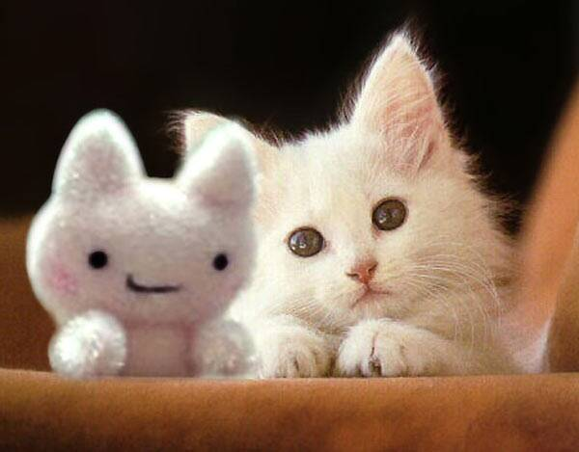
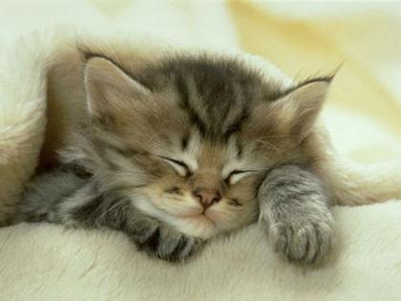
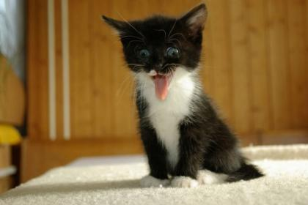
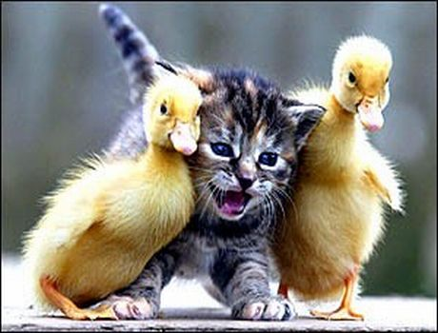

Slide 25
General or Specific?
Directions: Circle the example in each pair that uses effective specific details, rather than overly general detail. Then go back and underline the overly general adjective that the author used ineffectively.
1.) She wore a really pretty fancy cape.
A cape of purple velvet trimmed in soft white fur covered her shoulders.

Slide 26
Elaborative Details and Segments
Autumn/ Evil
Walk Around :
you and your partner will down as many examples as you can.
You must move every time you hear the music stop.
Do not copy something that is already written.

Slide 27
Menu of detail generating questions and sentence starters
Questions about a story critical character-
Questions about a story critical setting-
Questions to ask about a story critical object-

Slide 28
The Broken Record- flip the sentence subject
Example:
There was a palace in the distance.
In the distance stood a palace.
Directions: Revise this sentences by “Flipping the sentence” and using a more interesting verb.
There was a moat around the palace
There was a knight on the balcony.
There were alligators in the moat.
There was a tall stone tower at the corner.

Slide 29
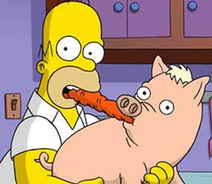
Elaborative Detail

Slide 30
What Feelings Look Like.
Another aspect of elaborative detail, of “showing rather than telling” involves the feelings of story characters.
Showing reactions to story events (both physical and emotional reactions) is a powerful means of reveling character, and allowing the reader to relate to the character.
However, when revealing a character’s feelings, it is always more powerful to “show” rather than “tell”:
“Showing” feelings involves facial and body movements. It can also involve the internal sensations of the main character.

Slide 31
Common Feelings
Feeling
Happy
Sad
Angry
Shocked
Tired
Hot
Cold
Frightened
What it Looks Like
Smile on face, heart leaps, jumps up and down, hands clasped together, eyes open wide.
Eyes well up, lips, quiver, heart drops, wring hands.
Brow furrowed, frown, fists clenched, heart pounds, stamp feet, teeth clenched
Mouth drops open, eyes open wide, heart pounds, cover mouth with your hand, jump back, gasp
Slump, yawn, eyes droop, legs feel heavy
Sweat beads on forehead, face gets red, wipe your brow, move slowly, fan yourself
Shiver, teeth chatter, hug yourself, blow into your hands, rub hands together.
Heart pounds, eye wide open, start to sweat, knees feel weak, butterflies in stomach, mouth drops open

Slide 32
“Actions speaks louder than words”
What does this mean? How might an author use this to their advantage?

Slide 33
Joey was really Shocked
Revise this by SHOWING rather than TELLING. Be sure to describe his facial expression, body language, and even any sounds he made!

Slide 34
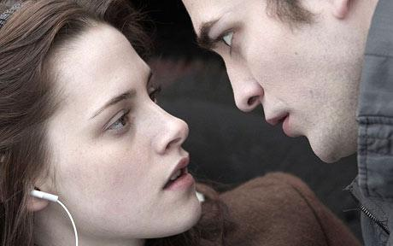
Suspense

Slide 35
A sense of suspense and anticipation is what hooks the reader and moves the story into the main event.
Suspense building raises questions in the reader’s mind
If the main character is wondering or worrying, so is the reader! The reader’s questions have to be answered.
Suspense, contrary to what people often think, does not have to be scary.
But another way to look at suspense is as story tension or a sense of anticipation.

Slide 36
There are several ways to build suspense or anticipation
1. Story Questions
Story questions can be raised directly or indirectly.
The simple way (directly) is to have your main character raise a question -to wonder or worry
The indirect approach involves telling the reader only part what is going on –just a hint. This raises questions in the readers’ mind and compels them to read on.

Slide 37
2. Word Referents
Tease the reader by not immediately revealing what “it” is. Describe a story critical character or object without naming it .
Example:
Instead of writing: I saw a dragon in the cave.
Use word referents: The creature was huge and dark as night. It made a soft rumbling sound. I could feel the mythical beast’s hot breath on my face.

Slide 38
3. The Magic of 3
This technique involves the convention in which a series of sensory hints (involving any of the senses) are provided in a way that builds tension- the third hint leading directly to a revelation.
You hear a noise. You look. Nothing. You dismiss it.
You see a fleeting shadow. Again, you try to determine what it could be, but don’t notice anything unusual. You start to worry.
You feel something brush past you. You turn. There it is! (revelation)

Slide 39
Red Flag Words and Phrases
When building Suspense, and particularly when using the Magic of Three, authors us RED FLAG WORDS AND PHRASES to grab the reader’s attention, to alert the reader to the fact that something significant is about to happen.
These RED FLAG WORDS AND PHRASES may be used effectively to introduce each hint in the Magic Three.
They can also be used effectively along with story questions and word referents. These transitional phrases help to move the action forward in a suspenseful way.

Slide 40
RED FLAG WORDS AND PHRASES
Suddenly
A moment later
The next thing I knew
In the blink of an eye
Instantly
Just then
All of a sudden
Without warning
To my surprise

Slide 41
The Main Event

Slide 42
The Main Event is basically what the story is all about
Everything so far should led up to one single, meaningful event or scene.
(A novel consists of many scenes that lead to one peak climatic event- a short story focuses on a single significant main event.)
In both the personal experience narrative and the character/ problem solution narrative – everything so lead to the main event.
The main event consists of the adventure, problem, or experience that changes or affects the main character in some way.

Slide 43
In the personal experience narrative crafting an effective main event involves adding a lot of elaborative detail and stretching out the significant event to high light its importance
In a character/problem/solution narrative, the author stretches out the challenges presented, and has the main character react to these challenges.- the tension is built-in.

Slide 44
Fully Elaborated Main Events are made of a balance of
Action
Description
Thoughts/feelings
Dialogue/exclamation
Sound Effect
* Don’t summarize! Make a Scene!

Slide 45
Detail Generating Questions
Action: What did you do?
(tell it in, slow motion, Play by Play, S-t-r-e-t-c-h i-t O-u-t)
Description: What did you see, hear, feel?
Thoughts/Feelings: What were you wondering, worrying, feeling?
Dialogue/exclamation: What did you say or exclaim?
Sound Effect: What did you hear?

Slide 46
Endings

Slide 47
When writing a story’s ending, you need to think about how your main character has grown or changed as a result of the main event it the story.
How is the main character better, wiser, or smarter? The last few sentences should sum up what the character learned, or how the character changed.

Slide 48
Ineffective Endings
An ending that is abrupt: “So I went home and went to bed,” is not satisfying for the reader.
Neither is a story that rambles on way past the conclusion because the author is uncertain about how to bring closure to it. (The next day… after that…etc.)
“Suddenly I woke up. It was just a dream.” this kind of ending is frustrating for the reader because the reader has invested energy in the story, only to discover none of it happened. We call this “pulling the rug out from under the reader.”

Slide 49
Techniques for Satisfying Ending
A Memory- Have the main character remember the main event.
A Feeling- sow how the main character felt about what happened in the story.
A Decision- include a decision made by the main character as a result of the main event or story problem.
A Wish or Hope- As a result of the main event, the main character thinks ahead and makes a wish or hope for the future.
A Defining Moment- As a result of the main event the main character does something that reflects a decision or a feeling. (this is a more sophisticated technique)

Slide 50
To Generate these Kinds of Endings
Asks the following productive questions:
A Memory- What do you remember most?
A Feeling- How did you feel after everything that happened?
A Decision- What did you decide to do after everything that happened?
A Wish or Hope- What did you wish or hope for?
A Defining Action- What did you do to show how you felt, or what you decided?

